Slide 1


Data Analytics Project - SQL
Digital Addiction Analytics
Understanding the impact of social media addiction on
Academics, Sleep, Mental Health & Social Life

Slide 2



Presented by
Rehan Ashraf
Aspiring Data Analyst | IIT Jodhpur
ashraflization
ashraf.lization@gmail.com
Rehan Ashraf

Slide 3
INTRODUCTION
  Smartphones and social media have become an essential part of student life.
  While they offer connectivity and information, excessive usage can turn into digital addiction.
  This addiction often impacts sleep patterns, academic performance, mental health, and social relationships.
Understanding these patterns through data can help identify the real extent of the problem.

Slide 4
PROBLEM STATEMENT
  Social media usage among students has increased significantly in recent years.
  Excessive screen time is linked to poor sleep, reduced academic focus, and declining mental health.
  However, the behavioral impact of digital addiction is often underestimated.
This project uses SQL to analyze student social media usage and identify patterns of digital addiction and its consequences.

Slide 5
DATASET OVERVIEW
  Dataset: students_addiction
  Total Records: 705 students
  Data Type: Survey-based student behavioral data
  Structure: Single, denormalized table

Slide 6
KEY ATTRIBUTES
  Daily social media usage (hours)
  Addiction score
  Academic performance impact
  Sleep duration
  Mental health score
  Social conflicts & demographics

Slide 7
PROJECT FLOW
  Data import into MySQL Workbench
  Schema optimization & datatype correction
  Data cleaning and standardization
  Feature engineering (usage & addiction segmentation)
  Exploratory data analysis using SQL
  Insight extraction & interpretation

Slide 8
DATA CLEANING & PREPARATION
  Optimized column data types for analysis
  Standardized categorical values (case & formatting)
  Validated numeric ranges (usage hours, sleep, scores)
  Checked for missing values and outliers

Slide 9
SEGMENTATION & FEATURE ENGINEERING
  Categorized students based on daily usage:
    Low (< 2 hours)
    Moderate (2–5 hours)
    High (> 5 hours)
  Grouped addiction scores into risk levels:
    Low Risk (1–3)
    Medium Risk (4–6)
    High Risk (7–10)

Slide 10
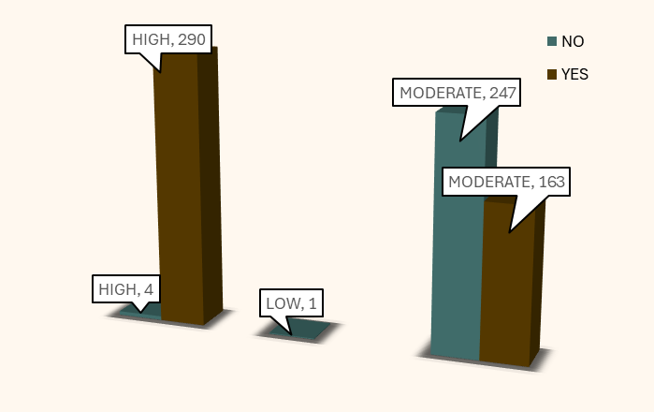
Screen Time vs Academic Performance
SELECT
CASE
WHEN Avg_Daily_Usage_Hours < 2 THEN 'LOW'
WHEN Avg_Daily_Usage_Hours BETWEEN 2 AND 5 THEN 'MODERATE'
ELSE 'HIGH'
END AS usage_level,
Affects_Academic_Performance,
COUNT(*) AS student_count
FROM students_addiction
GROUP BY usage_level, Affects_Academic_Performance;

Slide 11
Screen Time vs Academic Performance
  Students with high daily usage show a very high likelihood of academic impact.
  Moderate usage shows mixed academic outcomes.
  Low usage students report minimal academic impact.
Conclusion: Excessive screen time is strongly associated with academic performance issues.

Slide 12
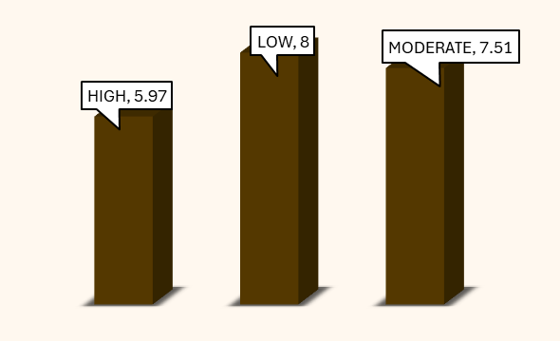
Screen Time vs Sleep
SELECT
CASE
WHEN Avg_Daily_Usage_Hours < 2 THEN 'LOW'
WHEN Avg_Daily_Usage_Hours BETWEEN 2 AND 5 THEN 'MODERATE'
ELSE 'HIGH'
END AS usage_level,
ROUND(AVG(Sleep_Hours_Per_Night), 2) AS avg_sleep_hours,
COUNT(*) AS student_count
FROM students_addiction
GROUP BY usage_level;
(Screen Time, Sleep Hours)

Slide 13
Screen Time vs Sleep
  Students with high daily screen time sleep significantly less than others.
  High usage students average less than 6 hours of sleep per night, indicating sleep deprivation.
  Moderate usage students maintain relatively healthier sleep durations.
  Low usage students show the highest average sleep, though sample size is limited.
Conclusion: Increased screen time is strongly associated with reduced sleep duration, which may contribute to academic and mental health issues.

Slide 14
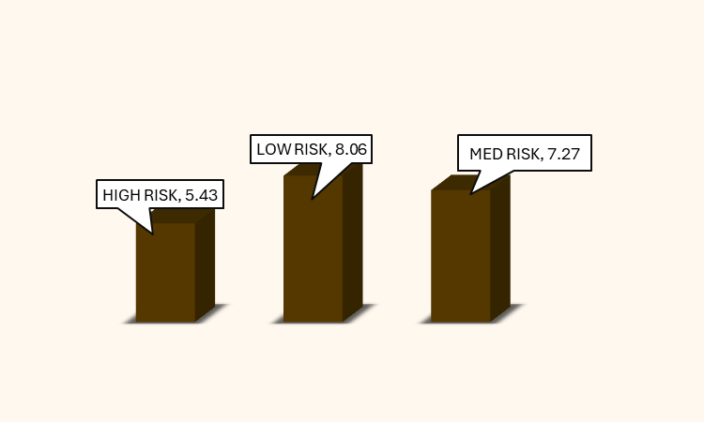
Addiction Score vs Mental Health
SELECT
CASE
WHEN Addicted_Score <= 3 THEN 'LOW RISK'
WHEN Addicted_Score BETWEEN 4 AND 6 THEN 'MEDIUM RISK'
ELSE 'HIGH RISK'
END AS addiction_risk,
ROUND(AVG(Mental_Health_Score), 2) AS avg_mental_health,
COUNT(*) AS student_count
FROM students_addiction
GROUP BY addiction_risk
ORDER BY addiction_risk;
(Addiction Score, Avg. Mental Health )

Slide 15
Addiction Score vs Mental Health
  Students with high addiction risk report the lowest average mental health scores.
  Mental health improves consistently as addiction risk decreases from high to low.
  This pattern indicates a strong negative relationship between social media addiction and psychological well-being.
Conclusion: Higher levels of social media addiction are associated with poorer mental health outcomes among students.

Slide 16
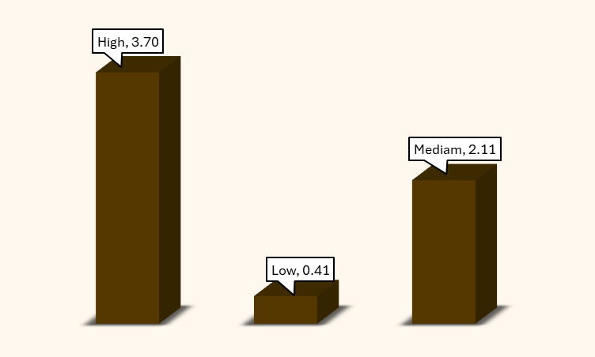
Addiction vs Social Conflicts
SELECT
CASE
WHEN Addicted_Score <= 3 THEN 'LOW RISK'
WHEN Addicted_Score BETWEEN 4 AND 6 THEN 'MEDIUM RISK'
ELSE 'HIGH RISK'
END AS addiction_risk,
ROUND(AVG(Conflicts_Over_Social_Media), 2) AS avg_conflicts,
COUNT(*) AS student_count
FROM students_addiction
GROUP BY addiction_risk
ORDER BY addiction_risk;
(Addiction Score, Avg. Social Conflict)

Slide 17
Addiction vs Social Conflicts
  Average social media–related conflicts increase steadily with addiction severity.
  Students in the high addiction risk group experience the highest level of conflicts.
  Low addiction levels are associated with minimal social conflicts.
Conclusion: Higher social media addiction is strongly associated with increased interpersonal and social conflicts.

Slide 18
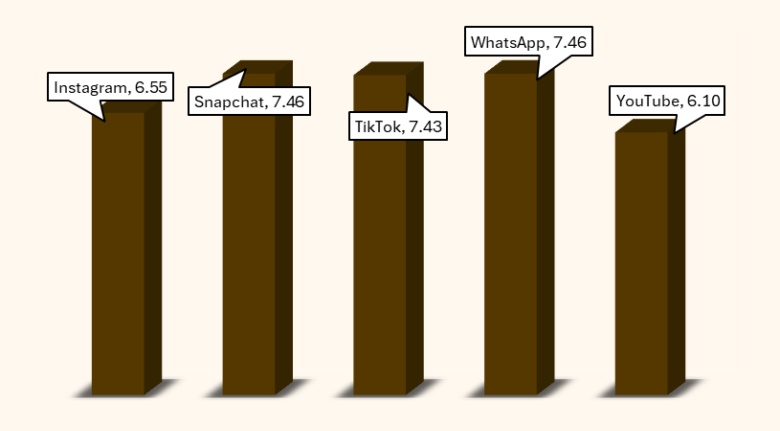
Platform-Wise Addiction Pattern
SELECT
Most_Used_Platform,
ROUND(AVG(Addicted_Score), 2) AS avg_addiction_score,
COUNT(*) AS student_count
FROM students_addiction
GROUP BY Most_Used_Platform
ORDER BY avg_addiction_score DESC LIMIT 5;
(Platform, Avg. Addiction Score)

Slide 19
Platform-Wise Addiction Pattern
  Addiction levels vary significantly across platforms.
  Certain platforms show consistently higher average addiction scores.
  This suggests that platform-specific engagement patterns influence addictive behavior.
Conclusion: Not all social media platforms contribute equally to digital addiction; some pose a higher addiction risk than others.

Slide 20
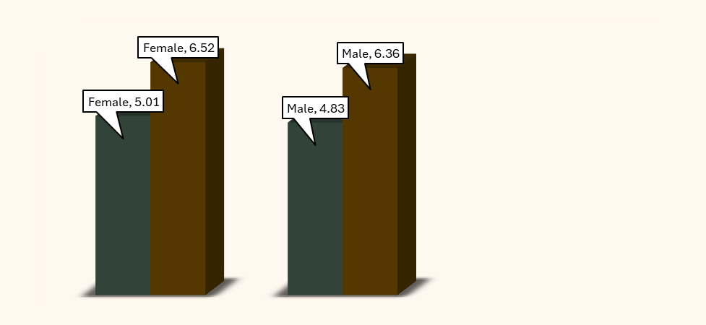
Gender vs Addiction & Usage
SELECT
Gender,
ROUND(AVG(Avg_Daily_Usage_Hours), 2) AS avg_daily_usage,
ROUND(AVG(Addicted_Score), 2) AS avg_addiction_score,
COUNT(*) AS student_count
FROM students_addiction
GROUP BY Gender;
(Gender, Avg. Screen TIme, Avg. Addiction Score)

Slide 21
Gender vs Addiction & Usage
  Gender-wise differences in screen time and addiction are present but not extreme.
  Both genders exhibit comparable addiction levels, indicating a broader behavioral issue.
  Addiction appears to be influenced more by usage patterns than gender alone.
Conclusion: Digital addiction is a cross-gender concern, not limited to a specific demographic group.

Slide 22
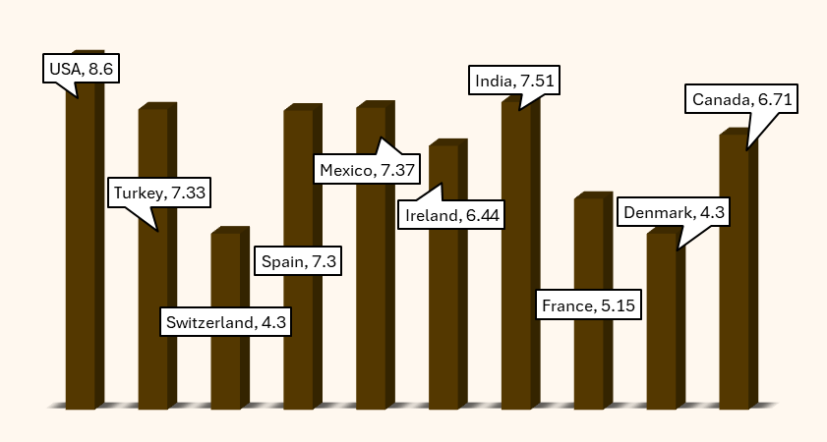
Country-Wise Addiction Pattern
SELECT
Country,
ROUND(AVG(Addicted_Score), 2) AS
avg_addiction_score,
COUNT(*) AS student_count
FROM students_addiction
GROUP BY Country
HAVING COUNT(*) >= 10
ORDER BY avg_addiction_score DESC LIMIT 10;
(Country,Avg. Addiction Score)

Slide 23
Contry-Wise Addiction Pattern
  Digital addiction levels vary significantly across countries.
  Countries like USA and India show the highest average addiction scores, even with larger sample sizes.
  Lower-ranked countries display substantially lower addiction levels, indicating regional differences in digital behavior.
Conclusion: Digital addiction is influenced by regional and cultural factors, highlighting the need for context-specific awareness strategies.

Slide 24
Executive Summary
This project analyzes student social media usage data to understand the impact of digital addiction on academics, sleep, mental health, and social relationships. Using MySQL-based descriptive and comparative analysis, students were segmented into usage and addiction risk groups.
Key findings show that high daily screen time is strongly associated with academic performance issues, with most high-usage students reporting negative academic impact. Increased screen exposure also correlates with reduced sleep duration, with heavy users averaging less than 6 hours per night. Additionally, higher addiction scores are linked to lower mental health scores and increased social media–related conflicts.
Platform-wise and country-wise analysis revealed that addiction levels vary across digital environments and regions. Overall, the results highlight that digital addiction is a widespread behavioral concern with measurable effects on student well-being and productivity.

Slide 25
Suggestions
  Introduce structured awareness sessions in schools to educate students about excessive screen-time risks.
  Encourage daily screen-time boundaries (e.g., < 5 hours/day) to reduce academic and sleep-related impact.
  Promote digital-free time before bed (at least 1 hour) to improve sleep duration and recovery.
  Provide counseling and stress-management resources for students showing high addiction and low mental health scores.
  Identify high-risk platforms and encourage mindful usage through app timers or restricted access during study hours.
  Encourage offline social interaction and family involvement to reduce conflicts and improve real-world connections.

Slide 26
Suggestions
This analysis highlights that social media addiction is a widespread behavioral concern among students. The findings show that excessive daily screen time is strongly associated with negative academic outcomes, reduced sleep duration, declining mental health scores, and increased social conflicts.
Platform-wise and regional variations further suggest that digital addiction patterns are influenced by both engagement environments and contextual factors. Overall, the project demonstrates how SQL-based analytics can uncover meaningful behavioral insights and support awareness-driven interventions.
Final Takeaway: Promoting balanced digital habits is essential for improving student well-being, productivity, and mental health.

Slide 27





Thank You!
---------------------

